Slide 1
Developing Innovative Ideas
in Science Education
in the Thai Context
Assoc. Prof. Dr. Khajornsak Buaraphan
khajornsak.bua@mahidol.ac.th
Institute for Innovative Learning, Mahidol University
®Khajornsak Buaraphan: Institute for Innovative Learning

Slide 2
Mourning the passing of our great and beloved
His Majesty
King Bhumibol Ajulyadej
1927 - 2016

Slide 3
In Remembrance of His Majesty
King Bhumibol Adulyadej
1927 - 2016
The Beloved King
http://www.bangkokpost.com/nation-in-mourning/

Slide 4
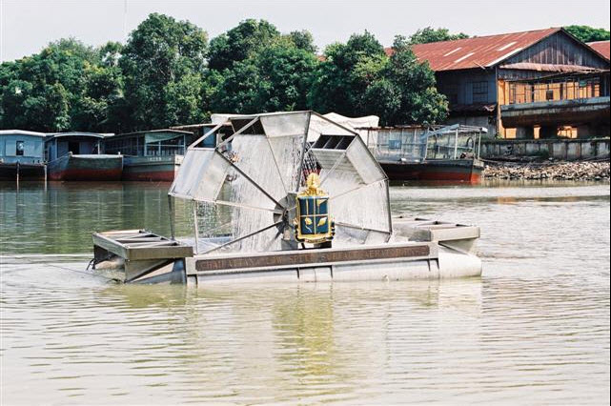
King Bhumibol Adulyadej:
The Father of Thai Innovation
On 2 February 1993 King Bhumibol became the world’s first monarch to be granted a patent for an aerator used in wastewater treatment (Chaipattana Aerator RX-2).
A later model, the RX-5, was patented on 19 April 2001.
http://www.chaipat.or.th/images/stories/english_web/Research/Aerator_1.jpg

Slide 5
King Bhumibol Adulyadej:
The Father of Thai Innovation
In the 1960s, King Bhumibol initiated artificial rainmaking research, and later royal rainmaking operations have greatly benefited farmers, easing water shortages and increasing agricultural production.
https://cdn01.vulcanpost.com/wp-uploads/2016/10/2015-11-10_20.09.42.jpg

Slide 6
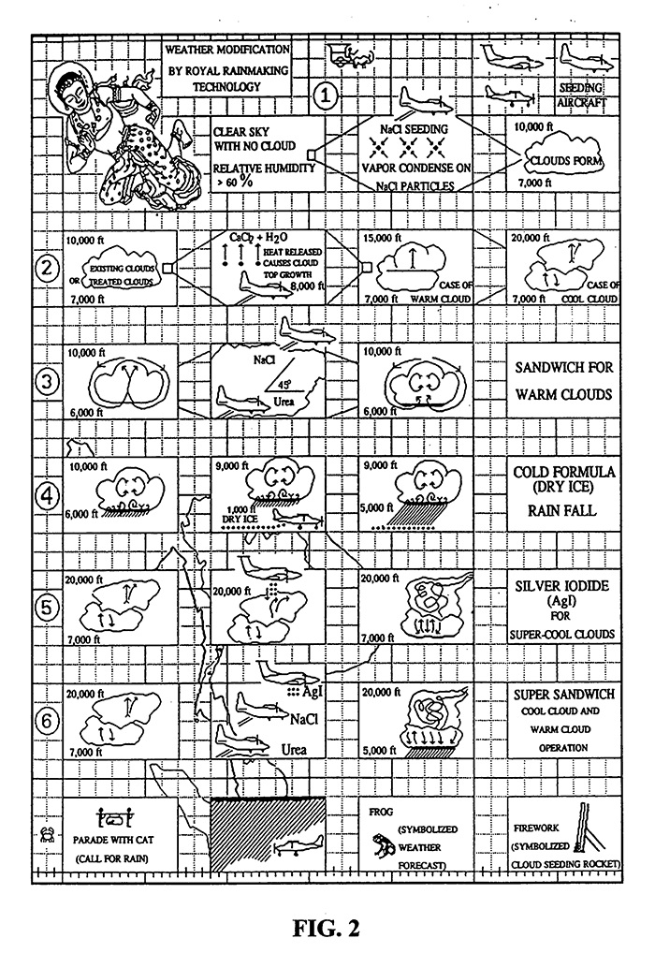
https://cdn01.vulcanpost.com/wp-uploads/2016/10/thai-rain-patent.jpg

Slide 7
King Bhumibol Adulyadej:
The Father of Thai Innovation
The Royal Rainmaking Project was granted a patent by the Department of Intellectual Property on 29 November 2002.
It was awarded the Gold Medal with Mention at the Brussels Eureka 2001, held in Belgium in November 2001.
The European Office issued a patent for Weather Modification by Royal Rainmaking Technology to His Majesty on 12 October 2006.

Slide 8
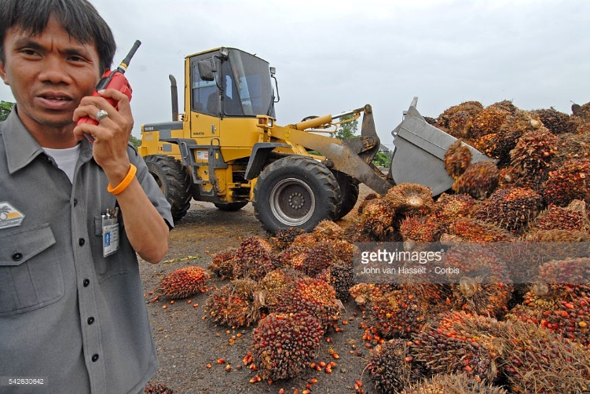
King Bhumibol Adulyadej:
The Father of Thai Innovation
In 1985, His Majesty the King initiated the production of “Biodiesel” as a way of applying indigenous means to achieve self-sufficiency in energy.
His formula was patented on 11 October 2002.
http://media.gettyimages.com/photos/palm-oil-fruit-at-the-crushing-mill-for-use-as-biodiesel-king-of-picture-id542630642

Slide 9
Source of Innovative Ideas
Fame
Love
Your Passion
an extreme interest in or wish for doing something for……
Career
path
Money
®Khajornsak Buaraphan: Institute for Innovative Learning

Slide 10
ที่ของข้าพเจ้าในโลกนี้คือการที่ได้อยู่ท่ามกลางประชาชนของข้าพเจ้า นั้นคือคนไทยทั้งปวง
My place in this world is the place I live
among all Thai people
(translated by the presenter)
http://www.bangkokpost.com/nation-in-mourning/

Slide 11
Source of Innovative Ideas
What is your “Passion” for creating innovation in science education?
…………..
®Khajornsak Buaraphan: Institute for Innovative Learning

Slide 12
Meaning of “Innovation”
Innovation
is both process and outcomes of creating something new, which is also of value. It involves the whole process from opportunity identification, ideation or invention to development, prototyping, production marketing and sales, while entrepreneurship only needs to involve commercialization.
®Khajornsak Buaraphan: Institute for Innovative Learning

Slide 13
Innovation distinguishes between a leader and a follower.
Steve Jobs
http://www.proactiverisk.com/wp-content/uploads/2015/09/stevejobsbig.jpg
®Khajornsak Buaraphan: Institute for Innovative Learning

Slide 14
Developing innovative ideas
Gap Analysis
Analysis of a gap between a current practice and an expectation in order to identify the problem
®Khajornsak Buaraphan: Institute for Innovative Learning

Slide 15
Problem
Reality
Expectation
Gap analysis
Water is not clean (wastewater)
Clean water
http://blogs-images.forbes.com/work-in-progress/files/2012/03/what-is-critical-thinking.jpg
®Khajornsak Buaraphan: Institute for Innovative Learning

Slide 16
Problem
Reality
Expectation
Gap
analysis
Current practices in science education in Indonesia
Goals of science education in Indonesia
INNO
VATION
http://blogs-images.forbes.com/work-in-progress/files/2012/03/what-is-critical-thinking.jpg
®Khajornsak Buaraphan: Institute for Innovative Learning

Slide 17
GPAOR: Transforming innovative ideas into innovation in science education
Gap
analysis
Reflect
Plan
Observe
Act
(Adapted from Kemmis & McTaggart, 1992: 10)

Slide 18
GPAOR table
G Gap analysis | P Plan | A Act | O Observe | R Reflect
Analyze for a Gap between reality and expectation | Plan to close or limit the gap (with action, materials, equipment, intervention, etc.) | Act upon the plan (act, employ materials/ equipment/ intervention) | Observe the results | Reflect upon the results Success Strength Weakness Other problem/ Gap
®Khajornsak Buaraphan: Institute for Innovative Learning

Slide 19
Examples of Using GPAOR
Gap Analysis
PAOR
Plan-Act-Observe-Reflect
It is very hard to find the parking lot. We lose more energy.
What Innovation needs to close this gap?
®Khajornsak Buaraphan: Institute for Innovative Learning

Slide 20
Video clip
®Khajornsak Buaraphan: Institute for Innovative Learning

Slide 21
Examples of Using GPAOR
Gap Analysis
PAOR
Plan-Act-Observe-Reflect
Students face difficulty to understand the abstractness of mechanism of muscle.
Model of Muscle Sarcomere

Slide 22
Model of Muscle Sarcomere
Shows the 3D and symmetric structure of the thick and thin filaments including the mechanism of how they work together in muscle sarcomere.
Jittivadhna, K. Ruenwongsa, P. and Panijpan, B. (2009). Advances in Physiology Education, 33(4), 297-301.

Slide 23
Examples of Using GPAOR
Gap Analysis
PAOR
Plan-Act-Observe-Reflect
Students face difficulty to understand the abstractness of DNA.
Model of B-form, right-handed helix, double stranded DNA
®Khajornsak Buaraphan: Institute for Innovative Learning

Slide 24
Model of B-form, right-handed helix, double stranded DNA
Shows a palindromic sequence that is specific to restriction enzyme, EcoR1. This sequence is 5’GAATTC 3’ and the complementary base paring is 3’CTTAAG 5’
Jittivadhna, K. Ruenwongsa, P. and Panijpan, B. (2009). Biochemistry and Molecular Biology Education, 37(4), 220-226.

Slide 25
Examples of Using GPAOR
Gap Analysis
PAOR
Plan-Act-Observe-Reflect
People in the rural areas in Thailand lack simple kit to test iodated salt.
I-Kit : A Field Test Kit for Iodated Salt
®Khajornsak Buaraphan: Institute for Innovative Learning

Slide 26
I-Kit : A Field Test Kit for Iodated Salt
I-Kit is a field test kit for iodate in salt with a newly formulated reagent (stable starch solution) which enables semi-quantitative estimation of iodate in salt (0-100 ppm iodine)
WHO & UNICEF
Report on Technical Consultation to Assess Rapid Test Kits Designed To Monitor Salt Iodine Content

Slide 27
Products of GPAOR
can be
New materials and equipment
New research instrument
®Khajornsak Buaraphan: Institute for Innovative Learning

Slide 28
Examples of Using GPAOR
Gap Analysis
PAOR
Plan-Act-Observe-Reflect
Lack of research instrument to explore students’ and teachers’ conceptions of nature of science.
Myths of Science Questionnaire (MOSQ)
®Khajornsak Buaraphan: Institute for Innovative Learning

Slide 29
Myths of Science Questionnaire (MOSQ)
Two options:
Multiple choices
Open-ended
Common alternative conceptions about nature of science (NOS)
Buaraphan, K. & Sung-ong, S. (2009). Asia-Pacific Forum on Science Learning and Teaching, 10(1), 1-22.
Quick & In-depth

Slide 30
Products of GPAOR
can be
New materials and equipment
New research instrument
Other things e.g. task, model, theory, formula, new ideas, etc.
®Khajornsak Buaraphan: Institute for Innovative Learning

Slide 31
Examples of Using GPAOR
Gap Analysis
PAOR
Plan-Act-Observe-Reflect
Lack of task to explore pre-service teachers’ conceptions of teaching and learning.
Metaphor Construction Task (MCT)
®Khajornsak Buaraphan: Institute for Innovative Learning

Slide 32
Metaphor Construction Task (MCT)
Describe a metaphor of teaching and learning science
Drawing the metaphor
Buaraphan, K. (2011). International Journal of Science Education, 33, 1571-1595.

Slide 33
Metaphor Construction Task (MCT)

Slide 34
What is your innovation?
Gap = Changes in National Education
Gap = Changes in Science Curriculum
Your classroom
C
D
B
E
A
F

Slide 35
GPAOR: Transforming innovative ideas into innovation in science education
Gap
analysis
Reflect
Plan
Observe
Act
(Adapted from Kemmis & McTaggart, 1992: 10)

Slide 36
GPAOR table
G Gap analysis | P Plan | A Act | O Observe | R Reflect
Analyze for a Gap between reality and expectation | Plan to close or limit the gap (with action, materials, equipment, intervention, etc.) | Act upon the plan (act, employ materials/ equipment/ intervention) | Observe the results | Reflect upon the results Success Strength Weakness Other problem/ Gap
®Khajornsak Buaraphan: Institute for Innovative Learning

Slide 37
Innovation in Science Education
is in your hands
http://gossipstar.mthai.com/media/upload/content/2012/01/09/33045-r-1326083664677
®Khajornsak Buaraphan: Institute for Innovative Learning

Slide 38
Thank You
Welcome for any sharing and discussion
®Khajornsak Buaraphan: Institute for Innovative Learning

